Slide 1
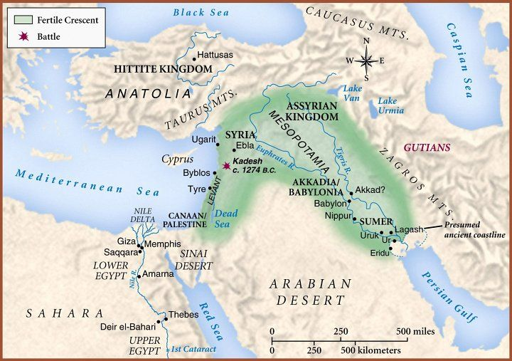
3. The Historical Torah
History that is recorded in writing may have started in Sumer and Akkadia around 3500 BCE, but, for Scripture, it started in Ur of the Chaldees, located in the Southeast corner of the Fertile Crescent. This was the birthplace of Abraham

Slide 2
The Beginning of the Biblical History
The Fertile Crescent is the land that gave birth to a number of peoples and a number of cultures
The Fertile Crescent seemed to be a cradle of civilization, as was the Indus River Valley in India, the Nile River Valley in Africa, many river valleys in North and South America and the Yellow River Valley in Asia
Many of the people living in Fertile Crescent seemed to speak one form or another of a Semitic language
Some of the inhabitants of the region began to take up farming and cities sprang up as places where farmed goods could be sold or traded
Some of the inhabitants raised animals instead of crops and lived a semi- nomadic life, moving to make sure that their livestock had sufficient grazing land and water
The Fertile Crescent was often the route used by traders from India and China to bring goods to the Sumerians, the Akkadians and later the Babylonians and Assyrians (old regimes) as well as to the Hittites in Asia Minor and to the Egyptians
This was the land in which Abraham was born, over which he traveled and in which he lived, died and was buried. This is the land where three major world religions had their birth. This is the land in which biblical history had its start

Slide 3
Who Was Abraham?
Abraham, then called Abram, was one of three sons born to Terah (sometimes spelled Thare). His brothers were named Nahor and Haran. Abraham was a descendant of Eber, from whom the Hebrew people derive their name (Gen.11:16-26)
Eber was the great-grandson of Shem who was one of the three sons of Noah. The Semitic people claim Shem as their ancestor (Semites/Shemites)
Terah gave the name Abram אַבְרָם to his son which means exalted father
Abram was one generation removed from Terah and another generation removed from Nahor. Nahor, was four generations removed Eber. Eber was three generations removed from Shem, after whom the Semitic people are named. Shem is one generation removed from his father Noah.
This all seems to indicate that Abram was 10 generations removed from Noah according to biblical reckoning (Noah, Shem, Arpachshad, Shelah, Eber, Peleg, Reu, Serug, Nahor¹, Terah, Abram)
¹ This Nahor was Abram’s grandfather. It seems clear that Abram’s brother, also named Nahor was
named after his grandfather (Gen. 11:10-26)

Slide 4
Why Is Abraham Important?
Abraham is considered the Patriarch of the Hebrew people through his son Isaac, born to wife wife Sara (originally named Sarai)
Abraham is considered the Patriarch of the Muslim people through his son Ishmael, born to his Egyptian slave girl, Hagar
Abraham is considered to be a patriarch of the Christian people via Isaac and Isaac’s descendants leading to Jesus (Matt. 1:1-17 and Luke 3:23-34)
God changes Abram’s name to Abraham (אַבְרָהָם) and his wife Sarai’s name to Sara when he establishes his covenant with him. The meaning of the name Abraham isn’t clear, but most likely means father of a multitude (Gen. 17)
It was also at this time, as the Hebrew people prospered, that God made his promise to Abraham of a territory that the Hebrew people could call their own
Abraham started his travels from Ur in the southeast end of the Fertile Crescent as far north as Haran, where his brother Nahor and his father Terah remained all the way down to the Southwest end of the Fertile Crescent in Egypt but Abraham settles in Canaan, the land promised to his by God
There is at least some validity to the claim that no single human being has affected more people than Abraham

Slide 5
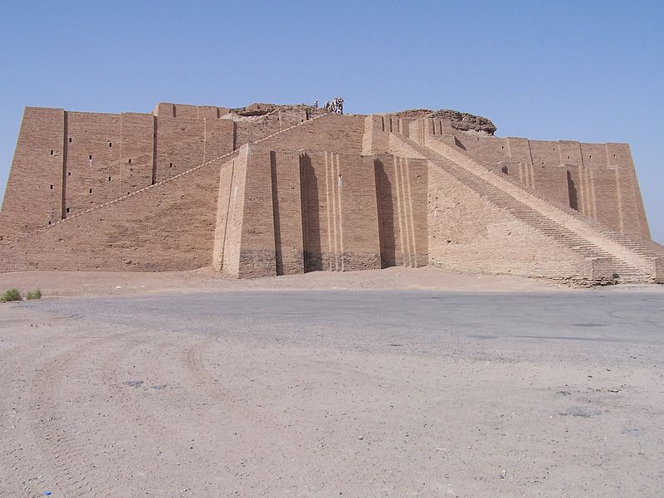
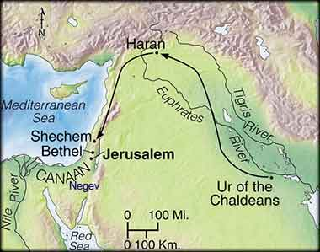
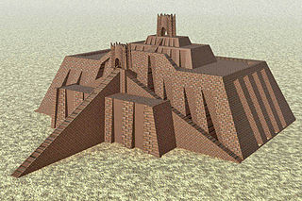
Where Was Abraham Born?
Genesis 11:28 tells us that Ur of the Chaldeans was the native land of Abraham’s family. Ur is located at the southeastern end of the Fertile Crescent. Ur, at the time of Abraham was ruled by the Ancient Babylonian Empire. The famous code-giver Hammurabi was one of their kings.
There was a famous ziggurat built in Ur that could well have been the famous Tower of Babel. When Abraham’s brother Haran died, the whole family moved north to…. yes, the town of Haran. Abraham’s father and brother Nahor remained in Haran. Abraham moved on to Canaan. Abraham’s family would, from time to time, return to Haran to visit their relatives

Slide 6
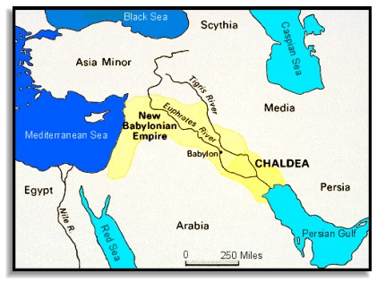
Is the phrase “Ur of the Chaldees” An Anachronism?
At the time of Abraham’s youth, Ur was a city in the Ancient Babylonian Empire. This was the Ancient Babylonian Empire of Hammurabi (@1800-1750 BCE). There was no region called Chaldea nor people called Chaldeans during Abraham’s time
The Chaldeans ruled the New Babylonian Empire more than a millennium after the time of Abraham
The Hebrew word translated as Chaldeans is כשדים
Kasdim.
The standard Hebrew-English Lexicon (Brown, Driver and Briggs, p.505) translates this word as Chaldeans, a people governed by Nebuchadnezzar, a Babylonian king who would not be born for more than a millennium.

Slide 7
Did Abraham’s Father and Brother Actually Remain In
a Town Called Haran?
When Abraham’s brother Haran died, the whole family moved north to a town that came to be called Haran, located at the northern tip of the Fertile Crescent.
Haran was the name of one of Abraham’s two brothers. Haran died before Abraham’s family left the city of Ur. How could they have moved to a town of the same name? Did the family establish the town and name it after their deceased brother? Or was it something else?

Slide 8
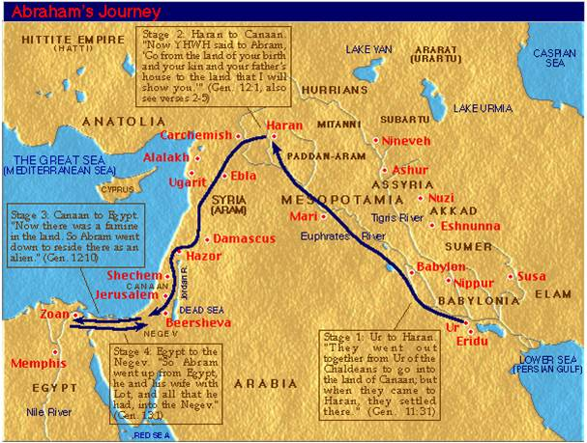
Something Else?
Abraham’s father and brother decided to remain at Haran while Abraham and his family, along with Nahor’s son, Lot, decided to journey on. This part of the story of Abraham has also raised a bit of a debate among scholars. The ruins of four cities in the region of Haran bear names closely resembling members of Abram’s family
The ancient town of Serugi (Modern Suruc) resembles the name of Abram’s grandfather, Serug
The ruins of Til Turakhi resembles the name of Abram’s father, Terah.
The ruins of Til Nakhiri resembles the name of Abram’s deceased brother, Nahor
The town of Haran clearly has the same name as Abram’s brother Haran
Where these ancient towns named after these ancestors of Abraham or did the earliest oral traditions of the Hebrew Scriptures remember these towns and assign their names to Abraham’s ancestors?

Slide 9
Why Are Abraham’s Travels Important?
Abraham traveled the full length of the Fertile Crescent. He was a prosperous herdsman. But Abraham settled in the land of Canaan which later became known as The Promised Land, a land sacred to this day to Jews and Christians, and Muslims as well. It’s hard to imagine, but nonetheless true, that Abraham’s travels almost four thousand years ago are still having a major impact on today’s history
Many of the places where Abraham stopped for some period of time before settling down became major shrines for the people of Israel and, later, for Samaritan Jews, Christians and Muslims
It’s fascinating to think that events that took place thousands of years in the past still affect current events

Slide 10
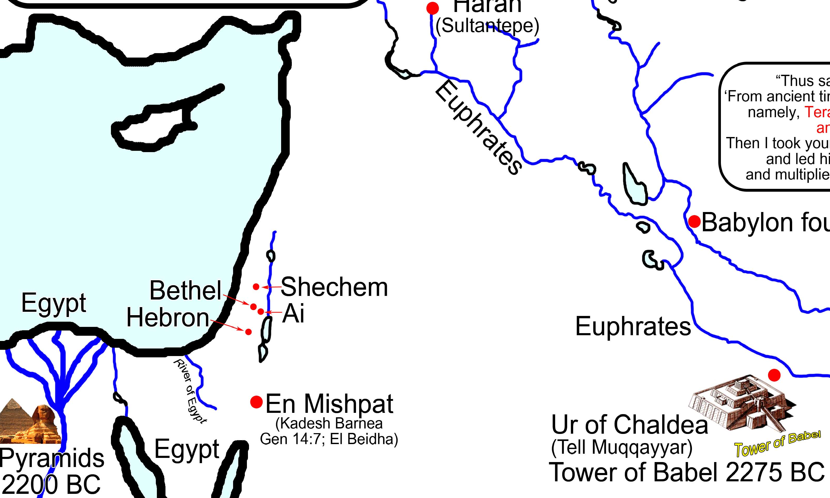
What Were Some of Those Shrines?
Shechem God appeared to Abraham at Schechem and promised the land to him and to his seed. Abram built an altar in Shechem in honor of God’s promise (Modern Nablus)
Bethel/Ai Abraham encamped at a place “east of Bethel and west of Ai”. Abram again built an altar there to the Lord. (Modern Bethel is Baytin)
.
Salem
Egypt Famine drove Abraham and his family into Egypt (the first story of Sara as Abram’s sister). This trip first established a relationship between Abram and Egypt that will play an important role in the history of his people
The LORD said to Abram: Go forth from your land, your relatives, and from your father’s house to a land that I will show you. I will make of you a great nation, and I will bless you; I will make your name great, so that you will be a blessing. I will bless those who bless you and curse those who curse you. All the families of the earth will find blessing in you. Abram went as the LORD directed him, and Lot went with him. Abram was seventy-five years old when he left Haran (Gen 12:1-4)
Hebron Abraham next moved to “the terebinths of Mamre” in Hebron where he built yet another altar. It was here that Abraham was first referred to as a Hebrew (Hebron is still Hebron)
Salem after a battle, Abraham met Melchizidek the King/Priest of Salem now called Jerusalem

Slide 11
Who Were Some of the People Abraham Met?
The Pharaoh of Egypt
Abraham wandered into Egypt during a time of famine. The Pharaoh found Sarah, his wife (now at least near 70 years old and pretending to be his sister) to be very beautiful and tried to take her into his harem. (Gen. 12:10-20)
Abimelech, King of the Philistine city of Gerar
Abraham wandered to the Negeb desert and encamped at the city of Gerar. There Abraham made a treaty with Abimelech, a Philistine and the King of Gerar. Sarah, again pretending to be Abraham’s sister, is once again taken into Abimelech’s harem but God warned Abimelech in a dream. Abraham and Abimelech made a covenant of peace at Beer-shebah. Abraham remained in the land of the Philistines for a significant period of time. It’s not clear if Abimelech is a name of a person or a title given to many kings in the region. Abi means “my father” and melech means “king”. (Gen. 20)
Melchizedek, Priest-King of Salem
Melchizedek offered bread and wine to Abraham in the city that was later to become Jerusalem. Melchi means “my king”. The name could mean “My king is righteous” or “My king is Zedek”. Salem is later called Jeru-salem.
(Gen. 14:18-20)

Slide 12
More History of Abram/Abraham
Ten years after Abram’s return from Egypt, his wife Sarai was well beyond the years of conception. Sarai encouraged Abram to sleep with her Egyptian slave, Hagar. Hagar gave birth to a son, Ishmael
Thirteen years later, God made a covenant with Abram and promised him the entire land of Canaan
- God changed Abram’s name to Abraham and Sarai’s name to Sarah
- God required circumcision as a sign of the covenant
- Abraham had all the males in his household circumcised including Ishmael
- God promised Abraham a son through his wife Sarah, despite her age
- The next year, Sarah gave birth to Isaac
- Sarah found it difficult having Hagar and Ishmael around so Abraham banished them from his household. Yet God promised Hagar that Ishmael would beget a great nation of his own (Gen. 17:20). Islam claims Arab descent from Abraham through Ishmael
Abraham wandered to the Negeb and encamped at Gerar.
- There Abraham made a treaty with Abimelech, a Philistine and the King of Gerar. The two made this covenant of peace at Beer-shebah. Abraham remained in the land of the Philistines for a significant period of time.

Slide 13
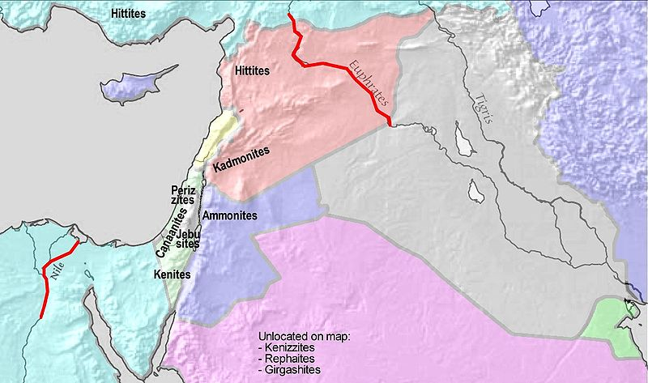
What Was God’s Promise to Abraham?
“On that day the LORD made a covenant with Abram, saying: ‘To your descendants I give this land, from the Wadi of Egypt to the Great River, the Euphrates, the land of the Kenites, the Kenizzites, the Kadmonites, the Hittites, the Perizzites, the Rephaim, the Amorites, the Canaanites, the Girgashites, and the Jebusites’.” Gen. 15:18-21
Interestingly, the Kingdom of Israel under David and Solomon expanded to almost exactly fit the dimensions of this promise leading some scholars to believe that the dimensions of the Promised Land weren’t written until the time of David

Slide 14
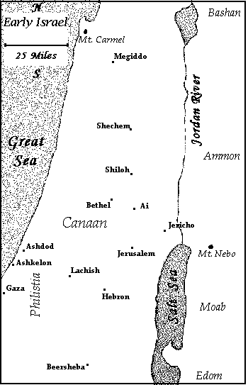
Who were “the Hebrews”?
Abraham is seen as the Patriarch of the Hebrew people but just who are these Hebrews? They are Semites, that is, descendants of Shem, one of Noah’s sons
Some linguists think the work Hebrew comes from an Egyptian word a-pi-ru which means ‘nomads’
The origin of the word that is most accepted for ‘Hebrew’ is the word עִבְרִי (Ib-ri). The word means “descendant of Eber (עֵ֫בֶר), a child of Shem (Gen. 10:21-25). The name Eber is related to the Hebrew verb a-bar (עָבַר) , to pass over or travel across. The name could imply that the people of Eber originally came from across the Euphrates River
A question can be legitimately asked if calling Abram a Hebrew meant that he was seen as a one of the semi-nomads or that he was a descendant of Eber or…that the Egyptians came to refer to all semi-nomadic peoples as descendants of Eber
“A survivor came and brought the news to Abram the Hebrew”
Gen.14:13

Slide 15
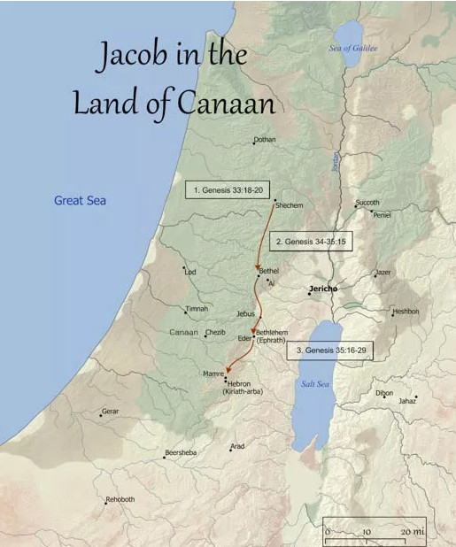
Who Were
the Canaanites?
The Canaanites were the original inhabitants of the Promised Land when Abram/Abraham first arrived in the region
Though linguistically a Semitic people (sons of Shem), the Canaanites are said to be descendants of Noah’s son Ham (Gen. 9). Ham was cursed by Noah when he failed to cover Noah’s nakedness. Noah went on to say, “May God give Japheth dwelling-space, and let him share the tents of Shem, but let Canaan be his slave.” Hamites are usually associated with Egypt and Africa. Some speculate that, since Egypt dominated the region from time to time, the Canaanites became associated with them
The Canaanites worshipped Baal, the son of El, their supreme creator god. The name Baal was not the actual name of the god but a substitution that meant something like ‘Lord’. The name of the god himself was probably Baal Hadad (akin to the Akkadian god Adad)
The Canaanites remained in conflict with the descendants of Abraham both politically and
religiously for many centuries

Slide 16
Who Were The Hebrew Patriarchs? Abraham, Isaac and Jacob
We know who Abraham was. Isaac was his son. Isaac was the boy that God told
Abraham to sacrifice on the heights of Mount Moriah (Gen. 22:1-19)
Abraham’s surviving brother, Nahor, was still living in the city of Haran. Nahor had a family of his own including a granddaughter named Rebekah. Abraham sent
Eliezer, his chief servant, to his relatives in Haran to seek a wife for Isaac
Eliezer met Rebekah at a well (where Jacob would meet his wife and where Moses his wife. We seem to have another pattern) and then met her brother Laban
Laban agreed to allow Rebekah to return with Eliezer to become Isaac’s wife
Isaac had since moved his own encampment to Beer-Lahai-Roi where he met Rebekah for the first time. He later made her his wife. Isaac and Rebekah had twin sons, Esau and Jacob. Esau came out of the womb of Rebekah first but Jacob, with Rebekah’s help, gained the patrimony by trickery. Jacob fled back to Haran to escape Esau’s wrath.
Jacob also sought a wife while in Haran. En route, Jacob stopped at Bethel where he had a vision of a ladder to heaven. God renewed the covenant promise He made to Abraham there to Jacob
Esau sought his own wife from the family of Ishmael. Red-haired Esau then lived in the red clay land of Edom. In Roman times, Edom was called Idumea, the birthplace of the family of Herod. In a sense, Esau reclaimed his birthright two millennia later when Herod the Great became king in Jerusalem

Slide 17
Is Genesis Genuine History?
The stories of Abraham, Isaac and Jacob take place in historical times.
They involve places that can be found even today
They mention peoples about whom much is known
While Abraham, Isaac and Jacob lived in historical times, the context of those times as explained in Genesis has raised a number of questions among scholars;
- Abraham was born in Ur of the Chaldees. We have already seen that there wouldn’t be Chaldeans in Babylon for another millennium
- We have already seen that the names of the members of Abraham’s family also seem to be names of towns in the region of Haran
- We have seen that the Promised Land was inhabited by Canaanites
- We have been told that Abraham encountered a Philistine King of Gerar. Who were the Philistines and where did they live?
- We were told that Abraham encountered Melchizedek. Who was he and where was Salem, the city which he ruled?
We’ll examine these last two questions in the next slides

Slide 18
Who Were the Philistines?
Part One
Though the Bible says that, at the time of Abraham, the Hebrews were at peace with the Philistines, they would later battle them over the course of many years. Since Palestine basically means land of the Philistines, one could say that the battles continue
The Philistines are first mentioned in Genesis (10:14) as coming from the Caphtorim
There is a debate about just who these Caphtorim were. The Jewish historian Josephus says that they were of the Mizraim (Egyptians) displaced from their land by a war with Ethiopia. Later scholarship believes that they were invaders from around Crete sometimes called The Sea Peoples
The serious debate is whether the Philistines were in the area at the time of Abraham. If they were Mizraim, it is quite possible. If they were from around Crete, then there may be a problem since the invasions from that region did not take place until hundreds of years later. It is not impossible, though, that Gerar was a small Cretan or Mycenaean Greek colony or trade station at the time of Abraham
Ekron
Gath ?

Slide 19
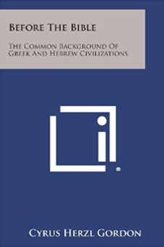

Who Were the Philistines? Part Two
I had thought that the meeting between Abraham and any Philistine was an anachronism. Then a friend of mine suggested that I read this book. It was written by Cyrus Herzl Gordon who was then considered a ‘rogue scholar’. He suggested there was a huge trading network throughout the Middle East and that trading bases had been established all along the Mediterranean Coast (and perhaps well beyond).
Recent archaeological discoveries seemed to be moving in the direction of Dr. Gordon. Pottery has been found in the region of the Philistines that is Mycenaean Greek in design but baked from clay in the local region. Could this “King of the Philistines” have been the leader of such a colony?
Dr. Eric Cline wrote a book called “1177 BC. The Year Civilization Collapsed.” In this book, he describes the trading that went on in the region before the collapse and suggested that the Peleset that invaded the region were actually Mycenaean Greeks. (More on Dr. Cline in the next Unit.)
Recent archaeology describes the attempts of the Hittite Empire (Hatti, located in mid to eastern Turkey) and the Mycenaean Greeks to influence a group of what might be called city-states in Western Turkey. One such state in the NW part of Turkey was called Wilusa. Homer knew that states as Ilium (Troy). Could the Myceneans have established colonies south of Hatti to enhance their position of influence in the region? In any case, Dr. Gordon may not have been such a rogue scholar after all.

Slide 20
Just Who Was Melchizidek?
His name in Hebrew is מַלְכִּי־צֶדֶק (Mal-chi-tze-deq) translated as “My King is Righteous”. It could also mean “My King is Tzadoq (Zadok)”. Hundreds of years after Abram/Abraham, during the time of Joshua, the King of Salem (later known as Jeru-Salem) was named Adonizedek (My Lord is Righteous or My Lord is Zadok). Interestingly, the name of the High Priest when David ruled from Jerusalem was Zadok.
Some scholars claim that Zedek/Zadok was the name of a local Jebusite deity and that Melchizidek really means “Zedeq/Zadok is my king”.
Melchizidek brought bread and wine and blessed Abram and the “God Most High” על עלין El Elyon. It is not surprising that Melchizidek, who rules a city in Canaan uses a generic Canaanite name for God על (El). But El was more than simply a generic name for God among the Canaanites. El was the chief God of the Canaanite people, the father of Baal Hadad. It is also said that El was the head of a council of Gods (Elohim ??)
Scholars asked why was this meeting even mentioned. We’ll look at some of their answers later. Talmudic scholars (see the Babylonian Talmud, Nedarim 32b) associate Melchizedek as being in a priestly line with Noah’s son Shem and that the meeting was a symbolic passing of that priesthood from Melchizidek to Abraham. Other scholars think the story was inserted into Genesis during David’s time to justify his decision to make Jerusalem his capital city

Slide 21
Why Was Isaac So Important?
Isaac seems to be almost a transitional or bridge character between Abraham and his grandson Jacob (next slide). Isaac does not seem to act very much. In fact, Isaac is almost always acted upon. Yet Isaac plays a serious role in the history of Judaism
The story of “The Binding of Isaac” may have symbolic importance to both Christians and Jews”
- For Jews, the occurrence took place on a mountain the region of Moriah. “Then Solomon began to build the temple of the LORD in Jerusalem on Mount Moriah “ (2 Chron. 3:1). Consider the importance of this story in the days after Solomon
- Given that the word used to describe Isaac (נַעַר ) (Naar) could mean any age from youth to age 37, Christians could easily see Isaac as a prefigure of Christ.
They could see him as “the lamb God would provide” (Gen. 22:8) at age 33.
Isaac does not find his own wife. Abraham’s servant is sent back to Haran to acquire a wife (Rebekah) from his family back in Haran. This contrasts with Isaac’s son Jacob who acts on his own behalf in Haran and winds up with two wives
Isaac is tricked by Rebekah to ensure that Jacob, not Esau, receives the birthright that by custom belonged to Esau. This story in Genesis describes an early relationship between the people of Edom/Idumea and the Hebrew people. This relationship, sometimes friendly and sometimes hostile, becomes important in the century before the birth of Jesus

Slide 22
Who Were Jacob and Israel?
Actually, they were the same person
Thanks to his mother’s help, Jacob succeeded Isaac as the leader of his people. He, too, returned to Haran to find a wife and there, as a result of Laban’s trickery, Jacob married Laban’s two daughters, Leah and Rachel
Jacob later attempted to reconcile with Esau. En route, he struggled with an angel and the angel told Jacob that he will be called by a new name, Israel
Jacob/Israel did reconcile with Esau. They parted in peace. Jacob then traveled back to Shechem where Abraham had set up an altar to God. Isaac later died in Hebron. Both Jacob and Esau returned to Hebron for his funeral
Jacob went on to father twelve sons; six by Leah (Reuben, Simeon, Levi ,Judah, Issachar and Zebulon), two by Leah’s maidservant Zilpah (Gad and Asher), two by Rachel (Joseph and Benjamin) and two by Rachel’s maidservant Bilhah (Dan and Napthali). These twelve became the patriarchs of the Twelve Tribes of Israel. Jacob also had a daughter by Leah. Her name was Dinah

Slide 23
Bad Things Happen to Joseph and Dinah
There were two events that happened to the children of Jacob that the Book of Genesis made part of its story
Genesis 34 tells of the rape of Dinah. Dinah, Jacob’s daughter, was visiting friends when Shechem (a person, not the place), a Hivite prince, saw her and took Dinah to bed. Jacob was angry but his sons were away. Just as his sons were returning, Shechem’s father brokered a deal that would promise that all Hivite men would be circumcised if Jacob would permit Shechem to marry Dinah. Jacob agreed but shortly after, while the Hivite men were still in pain, two of Jacob’s sons, Simeon and Levi, took their swords and slew every Hivite male including Shechem and his father and brought Dinah home
Genesis 37 tells how Joseph was sold by his brothers into slavery in Egypt. Joseph irritated his brothers so they sold him off and told Jacob that Joseph had been killed by a wild beast
Scholars questioned the purpose of each story. Some scholars concluded that the story of Dinah, where Simeon and Levi slew the Hivites, was told to explain why, in later times, the tribe of Simeon all but disappeared and the tribe of Levi never received lands of their own in the Promised Land. Being the priestly tribe, they would need to serve all the tribes. The story of Joseph was told as a means of explaining how the Israelites wound up in Egypt setting the stage for Moses

Slide 24
What Was The Testament of Jacob?
The Book of Genesis ends with the Testament of Jacob (Genesis 49) and the story of the death of Jacob and of Joseph (Genesis 50). With the end of the Book of Genesis, the Hebrew Scriptures have taken us from the time of creation through to the time of the Patriarchs. As Genesis ends, the Israelites have settled in Egypt under Pharaohs who have welcomed them.
The Testament of Jacob was a series of statements that Jacob issued regarding each of his sons. These statements were like a series of predictions about each son. The statement that Jacob gave concerning his son Judah was most important, “Judah is a lion’s cub, you have grown up on prey, my son. He crouches, lies down like a lion, like a lioness—who would dare rouse him? The scepter shall never depart from Judah, or the mace from between his feet, until tribute comes to him and he receives the people’s obedience. (Gen 49: 9-10)
Was the Testament regarding Judah another literary device designed to justify the leading role of Judah in the Kingdom of David and Solomon? Perhaps. The rest of the Torah will explain how the Hebrew people left Egypt and established themselves in Canaan. Our next section will deal with Moses and the Exodus

Slide 25
Is Genesis Historically Accurate?
The best answer to that question is an old saying:
Much of Genesis takes place in historical times. It speaks of events some of which actually happened and of people who actually lived.
It is important to remember that, for centuries, Genesis was passed down from one generation to another as an oral tradition. Literary devices can be found within Genesis that are common to stories passed down by oral tradition. These devices helped the story teller remember what stories when where and it helped keep the attention of those who listened to the stories
Here are a couple of examples. You can imagine the reaction of the Israelites enslaved in Egypt when they heard about Hagar, Abraham’s Egyptian slave girl
There is also the humor of a pun in the story of Joseph. In Hebrew, Joseph means “to increase”. Gen. 37:5 tells how the anger of Joseph’s brothers josephued (increased) over time. The pun only makes sense in Hebrew
There are also literary doublets; 1) There are two stories of Creation (Gen. 1:1- 2:3 and Gen. 2:4-25) 2) two genealogies of Adam (Gen. 4:17-26 and Gen. 5:1-32) and two stories of Abraham passing off his wife Sarah as his sister (Gen.12:10-20 and Gen.20:1-18). Isaac does the same thing with Rebekah in Gen. 26:7-11

Slide 26
Questions Left to be Asked
Given some of the points raised in the slides just presented, modern biblical scholars have begun to question if some of the people, places and things mentioned in Genesis really existed.
Consider the names of Abraham’s family members. Did he really have family members with those names or was Genesis trying to say something like, “And that’s how the town of Haran got its name, from Abram’s brother who settled there.” And a similar thing could be said for his grandfather Serug (the ancient town of Serugi), his father Terah (the ancient town of Turakhi) and his deceased brother Nahor (the ancient town of Nakhiri). Just like modern places became famous because George Washington might have slept there. Ancient places might have become famous because of their association with Abram/Abraham. Or inversely, perhaps this was an attempt to give Abram/Abraham greater status by claiming that towns were named after his family members
Did a similar thing happen with places where Abraham allegedly encamped. Were they mentioned to kind of say, “and that’s why to this day there is a shrine located at…”
Did the dimensions of God’s gift of the land to Abram/Abraham just happen to fit the Kingdom of Israel at the time of David and Solomon or were they chosen to justify the occupation of those lands by the Israelites at the time of David?
Similarly, was the Testament of Jacob written to justify the kingdom being ruled from a city in Judah and was the story of Melchizidek written to justify Jerusalem as being the city where the Ark of the Covenant was positioned, and the Temple was built?

